Slide 1
Bucket
Sort Algorithm
Bucket Sort

Slide 2

Submitted By
Pankaj Mahanto
ID: 213902002
Rabby Khan
ID: 213902037
Mostak Ahamed
ID: 213902126
Submitted To
Md. Sultanul Islam Ovi
Lecture, CSE Department
Green University of Bangladesh

Slide 3
What is Bucket Sort Algorithm ?
01
Bucket sort is a sorting algorithm that separate the elements into multiple groups said to be buckets. Elements in bucket sort are first uniformly divided into groups called buckets, and then they are sorted by any other sorting algorithm. After that, elements are gathered in a sorted manner.
The basic procedure of performing the bucket sort is given as follows -
First, partition the range into a fixed number of buckets.
Then, toss every element into its appropriate bucket.
After that, sort each bucket individually by applying a sorting algorithm.
And at last, concatenate all the sorted buckets.

Slide 4
Algorithm /Pseudo-code
02
function bucketSort(array, numBuckets):
// Step 1: Determine the range of input values
minValue = minimum value in array
maxValue = maximum value in array
// Step 2: Create empty buckets
buckets = create an array of empty lists
// Step 3: Distribute elements into buckets
for element in array:
bucketIndex = floor((element - minValue) / (maxValue - minValue + 1) * numBuckets)

Slide 5
Algorithm /Pseudo-code
03
buckets[bucketIndex].append(element)
// Step 4: Sort elements within each bucket
for bucket in buckets:
insertionSort(bucket) // or use any other sorting algorithm
// Step 5: Concatenate sorted elements
sortedArray = concatenate all elements from buckets
return sortedArray

Slide 6
Time Complexity
04
Best Case Complexity- The best-case time complexity of bucket sort is O(n + k).
Average Case Complexity -
The average case time complexity of bucket sort is O(n + K).
Worst Case Complexity –
The complexity will get worse when the elements are in the reverse order. The worst-case time complexity of bucket sort is O(n2).

Slide 7
Problem Scenario
05
Suppose you are working as a data analyst for a digital marketing agency. Your agency manages online advertising campaigns for various clients. As part of your role, you need to analyze and optimize the performance of these campaigns to maximize the click-through rates (CTR) of ad impressions.
Input Scenario:
Number of ad impressions: The data analyst provides the number of ad impressions in the campaign.
CTR values: The data analyst collects the click-through rate (CTR) values for each ad impression. These values represent the percentage of users who clicked on the ad after viewing it.
Output Scenario:
Sorted Impressions: The data analyst needs to obtain a sorted list of ad impressions based on their click-through rates (CTR). The sorted list will display the ad impressions in ascending order of CTR values.

Slide 8

06
All Step
How to Solved the Problem
01
Algorithm
Time Complexity
02
04
Java Implementation
03

Slide 9
How to Solved the Problem
07
Reading the number of ad impressions and CTR values:
The code starts by prompting the user to enter the number of ad impressions.
Then, it reads the CTR values for each impression from the user.
Performing bucket sort:
The bucketSort method is called to sort the CTR values using the bucket sort algorithm.
The bucketSort method takes an array of CTR values as input and returns a list of lists (List<List<Double>>), where each inner list represents a bucket containing CTR values falling within a specific range.
Determining the range and number of buckets:
In the bucketSort method, the minimum and maximum CTR values are determined using the min and max functions from the Arrays class.
The code then decides on the number of buckets (10 in this case) and calculates the interval size by dividing the range of CTR values equally among the buckets.

Slide 10
08
Creating the buckets:
A list of lists (List<List<Double>>) called buckets is created to hold the CTR values in different buckets.
A loop is used to initialize each bucket as an empty ArrayList.
Distributing the ad impressions into buckets:
Another loop iterates through each CTR value in the input array.
Based on the CTR value and the interval size, a bucket index is calculated, indicating which bucket the CTR value belongs to.
The CTR value is then added to the corresponding bucket.
Sorting the buckets:
After distributing the CTR values into buckets, another loop is used to sort each bucket.
The sort method is called on each bucket, which uses the default sorting order (ascending) to sort the CTR values within each bucket.

Slide 11
09
Concatenating the sorted impressions:
In the main method, a new ArrayList called sortedImpressions is created to hold the sorted CTR values.
A nested loop is used to iterate through each bucket and concatenate the sorted CTR values into the sortedImpressions list.
Printing the sorted impressions:
Finally, the code prints the header "Sorted Impressions" and iterates through the sortedImpressions list to display each CTR value.

Slide 12
Algorithm/Pseudo-Code
10
Read n from the user // Number of ad impressions
Create an array ctrValues of size n // CTR values for each impression
Read CTR values and store them in ctrValues array
minCTR = Minimum value from ctrValues
maxCTR = Maximum value from ctrValues
numBuckets = 10 // Number of buckets
intervalSize = (maxCTR - minCTR) / numBuckets // Size of each bucket interval
Create an empty list called buckets

Slide 13
11
for i = 0 to numBuckets - 1:
Add an empty list to buckets
for each ctr in ctrValues:
bucketIndex = (ctr - minCTR) / intervalSize
Add ctr to the bucket at bucketIndex in buckets
for each bucket in buckets:
Sort bucket in ascending order
Create an empty list called sortedImpressions
for each bucket in buckets:
Add all elements of bucket to sortedImpressions
Print sortedImpressions

Slide 14
Java Implementation
12
package Presentation;
import java.util.ArrayList;
import java.util.Arrays;
import java.util.List;
import java.util.Scanner;
public class BucketSortCTR {
public static void main(String[] args) {
Scanner scanner = new Scanner(System.in);
// Read the number of impressions
System.out.print("Enter the number of ad impressions: ");
int n = scanner.nextInt();
// Read the CTR values for each impression
double[] ctrValues = new double[n];
for (int i = 0; i < n; i++) {
System.out.print("Enter CTR for impression " + (i + 1) + ": ");
ctrValues[i] = scanner.nextDouble();
}

Slide 15
// Print the sorted impressions
System.out.println("Sorted Impressions:");
for (double impression : sortedImpressions) {
System.out.println(impression);
}
}
public static List<List<Double>> bucketSort(double[] ctrValues) {
// Determine the range of CTR values
double minCTR = Arrays.stream(ctrValues).min().orElse(0);
double maxCTR = Arrays.stream(ctrValues).max().orElse(100);
// Decide on the number of buckets
int numBuckets = 10;
double intervalSize = (maxCTR - minCTR) / numBuckets;
// Create the buckets
List<List<Double>> buckets = new ArrayList<>();
for (int i = 0; i < numBuckets; i++) {
buckets.add(new ArrayList<>());
}
13

Slide 16
14
// Distribute the ad impressions into buckets
for (double ctr : ctrValues) {
int bucketIndex = (int) ((ctr - minCTR) / intervalSize);
if (bucketIndex == numBuckets) {
bucketIndex--; // Place the maximum CTR value in the last bucket
}
buckets.get(bucketIndex).add(ctr);
}
// Sort the buckets
for (List<Double> bucket : buckets) {
bucket.sort(null); // Using the default sorting order (ascending)
}
return buckets;
}
}

Slide 17
Time Complexity
15
Reading Input: O(n), where n is the number of ad impressions.
Determining Range and Creating Buckets: This step has a time complexity of O(n)
Distributing Impressions into Buckets: This step has a time complexity of O(n), as it loops through the entire array of CTR values.
Sorting Buckets: O(m * log(m)), where m is the average number of impressions in each bucket.
Concatenating Sorted Impressions: This step has a time complexity of O(n), where n is the total number of impressions.
Therefore, the overall time complexity of the given code can be considered as O(n + m * log(m)), where n is the number of ad impressions and m is the average number of impressions in each bucket.

Slide 18
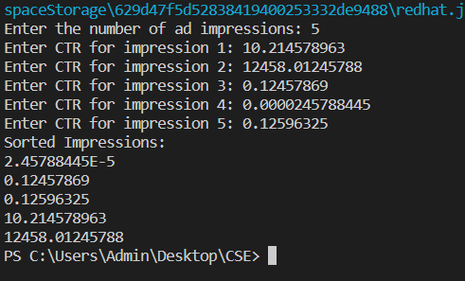
16
Input and Output
Enter the number of ad impressions: 5
Enter CTR for impression 1: 10.214578963
Enter CTR for impression 2: 12458.01245788
Enter CTR for impression 3: 0.12457869
Enter CTR for impression 4: 0.0000245788445
Enter CTR for impression 5: 0.12596325
Sorted Impressions:
2.45788445E-5
0.12457869
0.12596325
10.214578963
12458.01245788

Slide 19
Problem Scenario
17
Problem: When dealing with large datasets and performing range queries, bucket sort can be employed to quickly find elements falling within a given range. The elements are divided into buckets based on their values, and each bucket is sorted individually. This approach can significantly reduce the time complexity of range queries.
Input Format:
A large dataset of elements.
The range within which elements are to be queried.
Example: Suppose we have the following dataset:
[35, 12, 48, 20, 10, 30, 55, 42, 25, 17].
We want to find elements within the range of 20 to 40.
Output Format:
Output: The elements falling within the range [20, 40] from the given dataset are
[20, 25, 30, 35].

Slide 20
18
All Step
How to Solved the Problem
01
Algorithm
Time Complexity
02
04
Java Implementation
03

Slide 21
How to Solved the Problem
19
Determine the range of values in our dataset and the number of buckets I want to create. Divide the range equally among the buckets.
Create an array of empty ArrayLists, where the index represents the bucket and the ArrayList will hold the elements falling within that bucket.
Iterate through the dataset and distribute each element into the corresponding bucket based on its value. I can do this by calculating the index of the bucket using the formula: bucketIndex = (value - minValue) / bucketSize, where value is the element's value, minValue is the minimum value in the dataset, and bucketSize is the size of each bucket.
Sort each individual bucket. I can use insertion sorting algorithm .
Concatenate the sorted buckets back into a single sorted array or ArrayList.

Slide 22
Algorithm/ Pseudo-Code
20
function bucketSortRangeQuery(dataset, rangeMin, rangeMax, numBuckets):
// Step 1: Determine the number of buckets
// Step 2: Create and initialize the buckets
// Step 4: Assign elements to buckets
for each element in dataset:
bucketIndex = calculateBucketIndex(element, rangeMin, rangeMax, numBuckets)
add element to buckets[bucketIndex]
// Step 5: Sort the elements within each bucket
for each bucket in buckets:
sort(bucket)

Slide 23
21
// Step 6: Merge the elements from selected buckets within the range
result = []
startBucket = calculateStartBucket(rangeMin, rangeMax, numBuckets)
endBucket = calculateEndBucket(rangeMin, rangeMax, numBuckets)
for i = startBucket to endBucket:
for each element in buckets[i]:
if element >= rangeMin and element <= rangeMax:
add element to result
// Step 7: Return the result set
return result

Slide 24
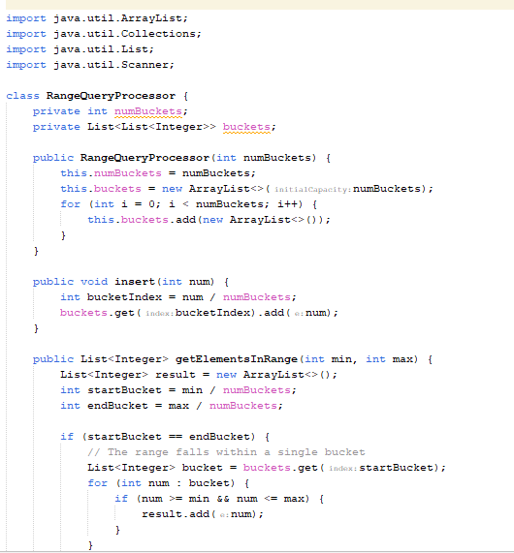
Java Implementation
22

Slide 25
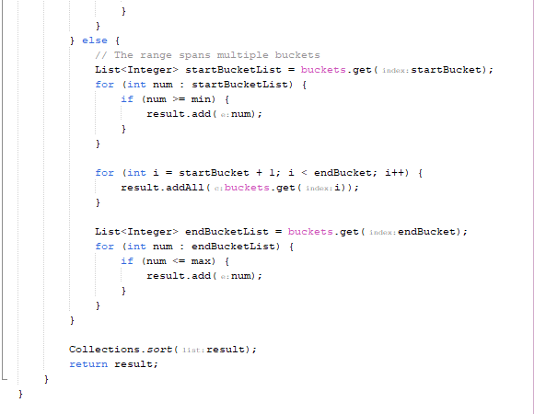
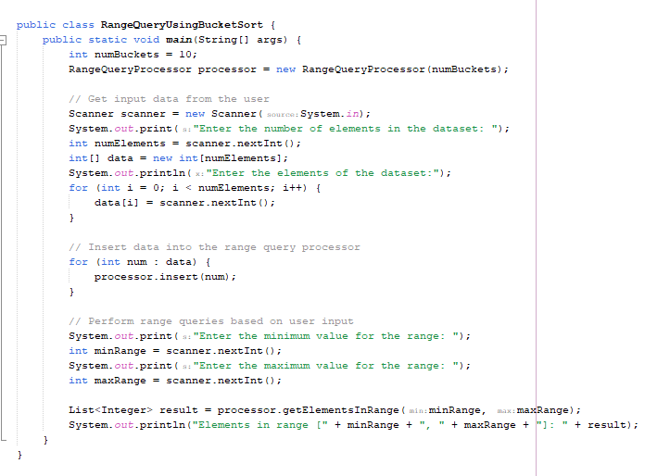
23

Slide 26
Time Complexity
24
The overall time complexity of bucket sort depends on the specific sorting algorithm used to sort the elements within each bucket.
If the buckets are relatively small and evenly distributed, bucket sort can achieve a linear average-case time complexity of O(n+k), where n is the number of elements and k is the number of buckets. However, in the worst case, when all elements fall into a single bucket, the time complexity can increase to O(n^2).
It's worth noting that bucket sort is more efficient when the input elements are uniformly distributed across the range. If the distribution is highly skewed, the performance of bucket sort can degrade.

Slide 27
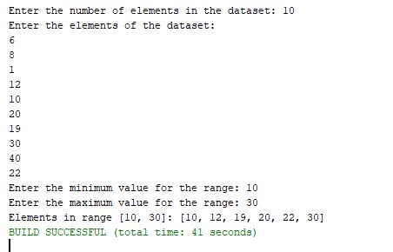
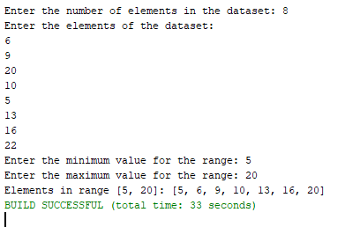
Input Output
25

Slide 28



Slide 29
THANK YOU

